Slide 1
Contemporary Issues in Adopting e-Procurement Practice in Government Acquisition Process:
The Professional Perspective
Fatai-idowu Onafowote
Director General, PPA

Slide 2
Introduction
e-Government refers to the use of digital technology by government bodies to enhance service delivery and citizen engagement. It can also be defined as the use of technology to deliver government services, exchange information, and conduct transactions with citizens, businesses, and other government agencies.

Slide 3
Benefits of Technology Integration
Technology integration in government operations leads to enhanced efficiency, reduced costs, and Improved transparency. By leveraging modern tools, governments can better meet the needs of their citizens and foster trust.

Slide 4
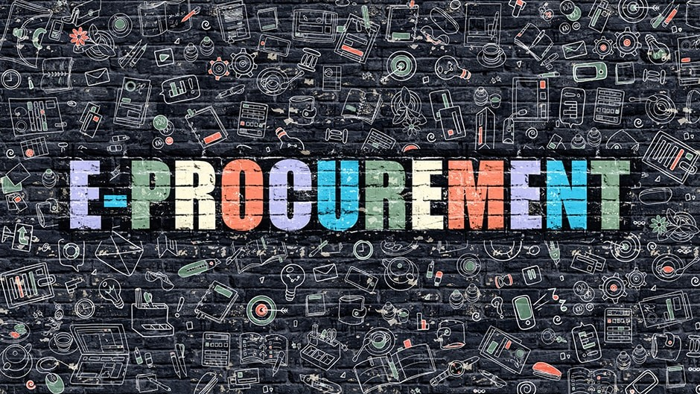
Lagos State Public Procurement Agency
The Agency is primarily set up to ensure
Probity
Accountability and
Transparency in Public Procurement by the State Government.

Slide 5
Principles / Objectives Of Public Procurement Process
ECONOMY
EFFICIENCY
- Flexibility
FAIRNESS
Effective Listening Skills
TRANSPARENCY
Diversified Knowledge
VALUE FOR MONEY
Priority and Result Focused
ACCOUNTABILITY
Ownership and Responsibility

Slide 7
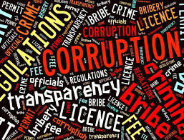
Forms of Corruption in Public Procurement
Bid-Rigging
This involves manipulating the bidding process to ensure that a specific contractor wins. This can include:
Creating tailored specifications that only a particular company can meet.
Sharing confidential bid information with favored bidders.
Disqualifying qualified bidders on arbitrary grounds.
Collusion among bidders to artificially inflate prices.

Slide 8
Kickbacks and Bribes
Kickbacks and bribes are common forms of fraud in public procurement. They occur when officials receive illicit payments from contractors in exchange for awarding contracts or securing favorable treatment. These practices undermine fair competition and erode public trust.

Slide 9
Inflated Contract Prices
Inflated contract prices occur when procurement officials collude with suppliers to artificially raise the costs of contracts. This can lead to significant losses for the government and misuse of public funds, as the actual value of goods and services is misrepresented.
Overstating the cost of materials and labor.
Creating "phantom" work items that are never actually performed.
Using change orders to increase contract values after the initial award.

Slide 10
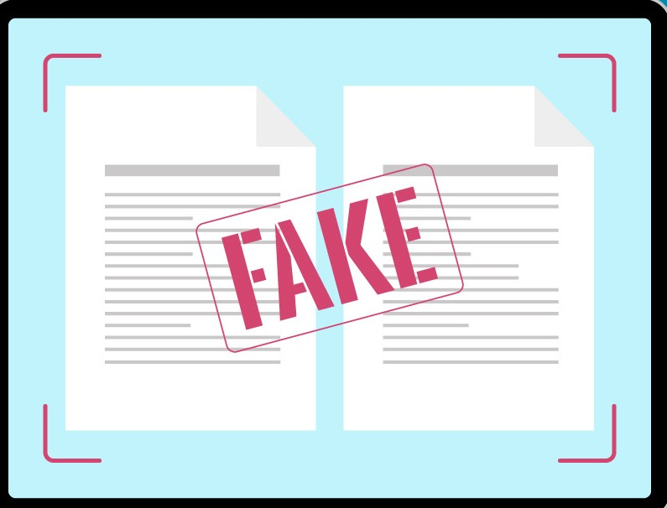
Falsification of Documents
This includes forging or altering procurement records to conceal corrupt activities.
This can involve:
Creating fake invoices.
Manipulating bid evaluation reports.
Altering payment records.

Slide 11
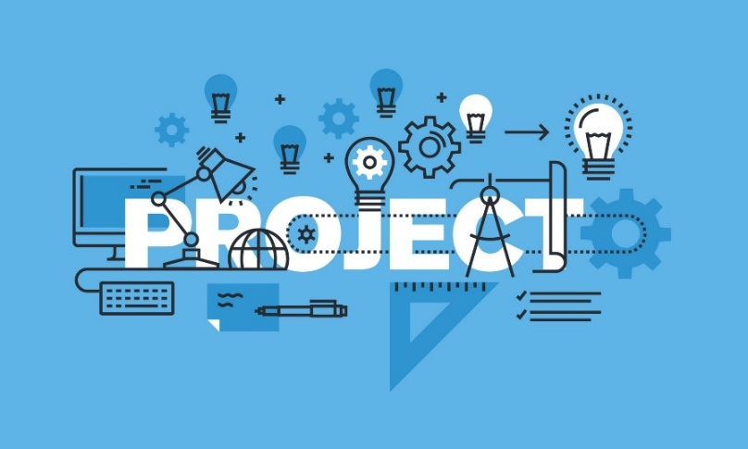
Phantom Projects
Phantom projects refer to non-existent initiatives that are created to siphon funds from public procurement budgets. These fraudulent schemes involve the submission of fake proposals and invoices for projects that are never intended to be executed. They represent a significant misuse of resources and can lead to widespread corruption.

Slide 12
Challenges/Underlying Factors
Weak Institutional Frameworks:
Inadequate enforcement of procurement laws and regulations.
Lack of independence and capacity within oversight agencies.
A weak judicial system that fails to prosecute corrupt officials.
Lack of Transparency and Accountability:
Limited public access to procurement information.
Absence of mechanisms for public monitoring and oversight.
A culture of secrecy that shields corrupt practices from scrutiny

Slide 13
Challenges/Underlying Factors
Political Interference:
Political patronage and influence in procurement decisions.
Protection of corrupt officials by political elites.
Use of public procurement as a tool for political fundraising.
Culture of Impunity:
A widespread belief that corrupt officials will not be held accountable.
Lack of public outrage and social sanctions against corruption.
Social pressures that encourage corrupt practices.
Technological Gaps:
Lack of effective technological systems, that would increase transparency, and track procurement processes.

Slide 14
Impact of Corruption in Public Procurement
Erosion of Public Trust: Undermines public confidence in government and its institutions.
Reduced Efficiency and Effectiveness: Diverts resources from essential public services.
Increased Costs: Leads to higher project costs and reduced value for money.
Hindrance to Economic Development: Discourages investment and stifles economic growth.
Social and Political Instability: Can fuel social unrest and political instability.

Slide 15
Solutions
Leveraging Technology:
Legal and Institutional Reforms
Promoting Transparency and Accountability:
Fostering a Culture of Integrity:

Slide 16
Key Advantages of the E-Procurement System
Efficiency and Cost Savings:
The e-Procurement system enhances transparency and accountability, leading to significant cost savings.
Single Window Portal:
A centralized platform for all procurement activities, ensuring ease of access and streamlined communication.
Ease of Doing Business:
Strengthened partnerships with stakeholders, making Lagos State a more attractive environment for business and investment.

Slide 17
Lagos State e-Procurement: Case Study
2024 - total of 159 MDAs on the e-procurement platform.
E-Evaluation Module Expansion: 15 additional MDAs began using the e-evaluation module in 2024, making a total of 45 MDAs.
E-Award System: Training for the e-award system has been completed, but the deployment of the system is still pending.

Slide 18
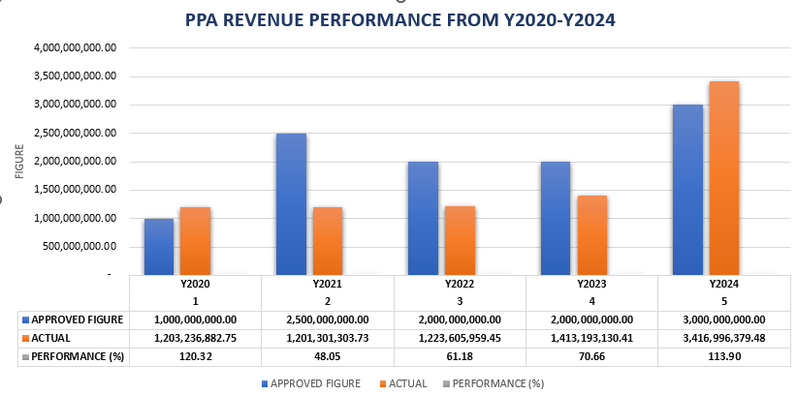

Slide 19
Conclusions
To enhance citizen engagement, governments must adopt user-friendly technologies and actively solicit feedback. Engaging citizens through surveys and digital platforms can lead to improved services and higher satisfaction.
In conclusion, embracing e-government and technology integration is essential for enhancing revenue growth and service efﬁciency. By leveraging digital tools, governments can better serve their citizens and foster a more transparent and accountable society

Slide 20
Questions?

Slide 21
Thank you!
www.lagosppa.gov.ng

