Slide 1
.
C H A R T E R E D I N S T I T U T E O F P U R C H A S I N G A N D S U P P L Y M A N A G E M E N T O F N I G E R I A.
Presents a Paper
,
Titled: The Roles and Contribution of Nigerian Supply Chain Professionals to the Africa Continental Free Trade and Its Multiplier Effect On Export Promotion Initiative of The Federal Government.
THEME: SUSTAINABLE PROCUREMENT AND SUPPLY CHAIN MANAGEMENT IN NIGERIA: A NECESSARY ROUTE TOWARDS ACHIEVING EFFICIENT MANAGEMENT OF RESOURCES IN PUBLIC AND PRIVATE SECTOR ORGANIZATIONS AND ITS IMPACT ON AFRICA CONTINENTAL FREE TRADE AREAS.
AT THE BATCH “A” MANDATORY PROFESSIONAL DEVELOPMENT PROGRAMME (MPDP) OF THE INSTITUTE FOR MEMBERS ONLY.
BY,
Dr Abdul A. Mamman MNIM, , CPA, FCIPSN
Coordinator, CIPSMN, North Central Zone
VENUE: KAGOS AIRPORT HOTEL, 111, OBAFEMI AWOLOWO WAY, ALLEN AVENUE JUNCTION, IKEJA – LAGOS.
Held on the 23rd – 25th April, 2025

Slide 2
Objectives of this paper
This paper aims at presenting a summary of the journey undergone by old NIPSM, before her establishment by an Act of Parliament with reference to her core mandate as well as, evaluating the Roles and Responsibility of Supply Chain Professionals in Nigeria and Extending such Role to the Implementation Agenda of the Africa Continental Free Trade Areas regarding the Concepts, Practices and Strategies involved towards, the Realization of The Common Objectives of Free Trade Across Africa with Specific Reference to its Multiplier Effect On Nigerian Export Promotion Initiatives.

Slide 3
Introductory Comment about the Chartered Institute of Purchasing and Supply Management of Nigeria.
A group of Nigerians we today referred to as the founding members of the institute, came together in the year 1974, and founded the then Nigerian Institute of Purchasing and Supply Management with a view, to domesticating the practice anchored on professional excellence as regards, the general acquisition process, procedures, rules with the fundamental objective of reducing the hardships faced by citizens of the Nigerian state, in their efforts in purchasing hard foreign currency for the payment of examination fees and other charges.
By the year 1984, a further effort was put into action in line with the requirements of the Company and Allied Matters Act (CAMA), where the body NIPSM was registered at the Corporate Affairs Commission through Trustees. At that moment, the institute began to train, conduct research, training and evaluating purchasing managers on their performances to helping government decision makers regarding, the national budget as well as, the purchasing managers in private sector organizations and conducting qualifying professional examinations approved by the federal ministry of education.
After several attempts aimed at having successive military administrations in Nigeria, to give full recognition to the institute by supporting her quest for establishment by decree and include the qualifications in the scheme of service failed, it is on record that, the General Abdulsalami’s military administration in 1999, almost signed the Bill into Law by the Armed Forces Ruling Council (AFRC) in the office of the then Chief of General Staff Late Admiral Mike Okhai Akhigbe but, it was not meant to be before the military administration handed over power on May 29th, 1999.

Slide 4
Introduction to CIPSMN…. Cont’d.
The new leadership of the institute including, team members as at then, mobilized through a strategic window of opportunity, by meeting with the Africa Region World Bank Director, Mr Rogatti who invariably, was a personal friend of the current Registrar/CEO of the institute, Prof. M’J. Aliyu FCIPSN and his team sought for his assistance towards supporting the institute’s quest for establishment through an Act of Parliament and recognition by the federal government of Nigeria especially, during the proposed economic reform initiatives being considered by the administration of former President Olusegun Obasanjo GCFR, of which procurement reform is the most significant element in the entire reform agenda.
Upon the birth of 4th Democratic Republic in 1999, the institute leadership in the year 2020 renewed discussion with the World BANK Country office under the African Region. The institute went further by approaching the National Assembly and seeking their support towards enabling the institute to be recognized through an Act of Parliament in line with what obtains in other democratic nations of the world.

Slide 5
Introduction to CIPSMN….. Cont’d.
A bill was prepared and presented to the National Assembly for consideration unfortunately, it took the cursory look of the then institute leadership under Prof. M.J. Aliyu Registrar/CEO, to discover that, an individual who was privy to the submission of the first proposed Bill, went behind and retrieve the Bill. The determination of the leadership and team members was further put to test and rather than allowing those, who do not wish the institute well to triumph, a new Bill was put together again and a re-submission was made to the National Assembly for proper legislative work. it would have passed in the Senate by the year 2003 but, the contestation among members of the Marketing institute in Nigeria, caused the delay through unresolved stand by the opposing parties.
The institute, upon inauguration of the 5th National Assembly commenced the process all over again. To the glory of God Almighty, the Bill went through the crucible of Legislative enactment in both houses of the National Assembly and a clean copy was passed to the then President Olusegun Obasanjo GCFR, for his assent which, was finally granted on the 30th April, 2007 and thus birthed the Chartered Institute of Purchasing and Supply Management of Nigeria via CIPSMN Establishment Act 21 of 2007.

Slide 6
Introduction to CIPSMN…… cont’d.
Reflecting on the success, other achievements were recorded post establishment towards positioning the institute in exercising of her core professional mandate among which are:
Conducted the National Election to elect National Executive Officers in 2010.
Received the report on accreditation and evaluation of the certificates and qualifications of the institute by the Federal Ministry of Education, Abuja in 2008.
Inclusion of the certificates and qualifications of the institute into the scheme of service by the National Council on Establishment in 2013
Recognition of the institute’s certification in the Presidential Executive Order 05 for Contract execution , local content policy in contract award for Science, Engineering and Technology – 2020
Currently in the National Assembly seeking a change in name to Chartered Institute of Procurement and Supply Chain Management of Nigeria in line with global best practices (pending at the National Assembly). - 2024

Slide 7
Supply Chain Management : The Roles and Responsibilities of Professionals
Supply Chain Management refers to the coordination and management of activities involved in sourcing, producing and delivering products or services to customers. It encompasses a network of organizations, people and activities that work together to create value for customers.
According to a world renowned author in supply chain management Upendra Kachru, is involved in the process of planning, implementing and controlling operations for serving customers as efficiently as possible. It encompasses all activities involved in sourcing , procurement, conversion and logistics. This is reflected in the operations of an organization which focuses on optimization of activities in the supply chain with a view to transporting the finished product using various modes of transportation to distribution centers, and ultimately to consumers. The entire process of an organization involved in collection and delivery and return journey of the organization box is a perfect example of excellence in supply chain management.

Slide 8
Key Components of Supply Chain Management
* Supply Chain Planning – Forecasting demand, planning production and managing inventory.
Sourcing - Procuring raw materials, goods or services from suppliers.
Production – Manufacturing, processing or assembling products.
Logistics and Transportation – Moving goods from one place to another
Inventory Management – Managing stock levels, storage and distribution.
Distribution – Delivery products to customers.

Slide 9
Goals of Supply Chain Management
Improve Efficiency – Streamline processes, reduce waste and increase productivity
Reduce Costs – Minimize costs associated with sourcing, production and logistics
Enhance Customer Satisfaction – Deliver products on time, in good condition, and with excellent service.
Mitigate Risks – Identify and manage risks associated with supply chain disruptions.

Slide 10
Benefits of Effective Supply Chain Management
Increased Competitiveness – Improved efficiency, reduce costs and enhanced customer satisfaction
Better Decision Making – Data – driven insights inform supply chain decisions
Improved Collaboration – Stronger relationships with suppliers, partners and customers
Increased Agility – Ability to respond quickly to changes in demand or market conditions
Finally, effective supply chain management is crucial for businesses to remain competitive, improve customer satisfaction and increase profitability.

Slide 11
The Roles and Responsibilities of Supply Chain Professionals
Having understood that, the supply chain management is a critical component of any organization, ensuring that goods and services are delivered to customers efficiently and effectively. Supply chain Professionals play a vital role in managing the flow of goods, services and information from raw materials to end customers.
We will further explore the roles and responsibilities of supply chain professionals and their importance in today’s business landscape.

Slide 12
Roles of Supply Chain Professionals
Supply chain professionals are responsible for managing the entire supply chain, from sourcing and procurement to logistics and distribution. Some of the key roles of supply chain professionals include:
Supply Chain Manager: Oversees the entire supply chain, ensuring that goods and services are delivered on time, in the right quantity and at the right cost.
Procurement Manager: Responsible for sourcing and procuring raw materials, goods and services from suppliers.
Logistics Manager: Manages the movement of goods from one place to another, ensuring that products are delivered on time and in good condition.
Inventory Manager: Responsible for managing inventory levels, ensuring that products are available when needed and minimizing stock-outs and overstocking as well as optimizing inventory turnover.
Supply Chain Analyst: Analyze data to identify trends, optimize supply chain operations and improve overall efficiency.

Slide 13
Responsibilities of Supply Chain Management
Strategic Planning
Supplier Management
Inventory Management
Logistics and transportation
Risk Management
Date Analysis
Collaboration and Communication

Slide 14
Skills and Qualities of a SCM Professional.
Supply chain professionals play a critical role in ensuring that goods and services are delivered to customers efficiently and effectively. Their roles and responsibilities are diverse, requiring a range of skills and qualities.
Analytical Skills
Communication Skills
Problems Solving Skills
Strategic Thinking
Collaboration and Teamwork
As the business landscape continues to evolve, supply chain professionals must be adaptable, innovative and customer – focused to meet the changing needs of customers and stakeholders therefore, we should invest in supply chain talent, implement supply chain technology and foster collaboration.

Slide 15
Enter Africa Continental Free Trade Area…

Slide 16
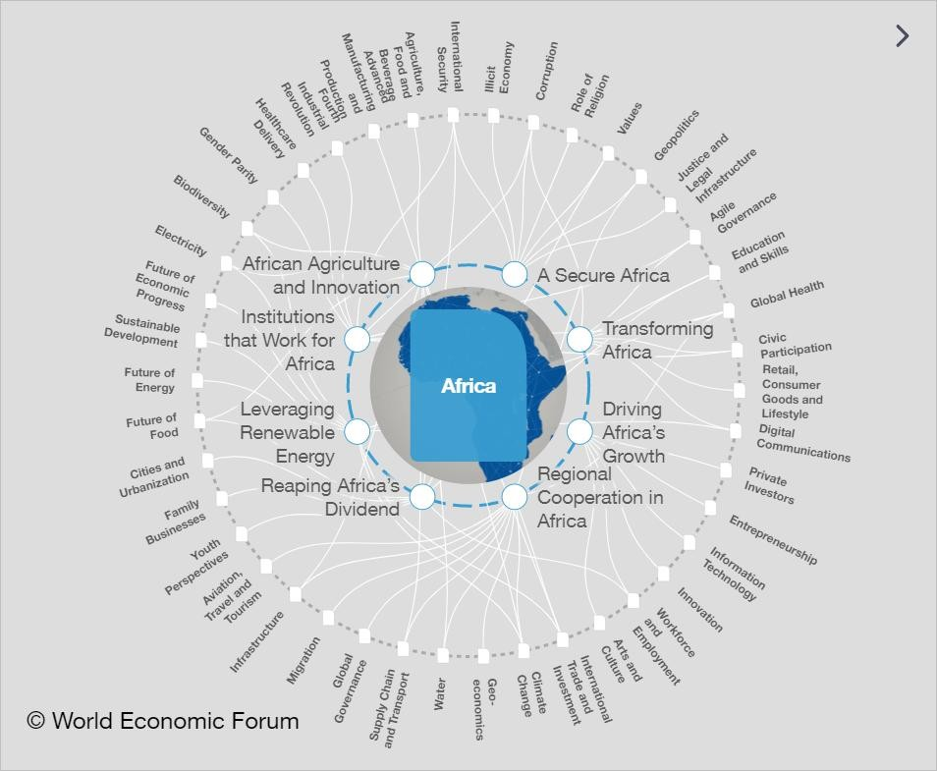
Africa: A Complex Reality
* The diversity of the
continent
* The African reality is
fascinating and complex yet
AfCFTA primer within the
AU’s Agenda 2063
* Focus areas of Africa
Agenda 2063 and the Inner
Core of the Transformation & Progress of the Region

Slide 17
Panoramic View of Africa’s Geo-Strategic Situation
Economic Policy Implications
• Production capacity for taking care of
immediate pressing needs
. Economic Distance/Inequality
Unemployment/Jobs/Recovery
- Wealth Creation & Wellbeing
• Development financing & debt problems
• Value addition, capacity & capabilities
• Supply chains & regional connectivity
Political Priorities – Choices
• Restless youthful population
• Look East Policy – China/Russia
• Regional integration/Nation Building
• Continental development & unity
• Economic growth = Infrastructure
Led Growth # Development for
Ordinary Citizens
• Essential Political SALES JOB

Slide 18
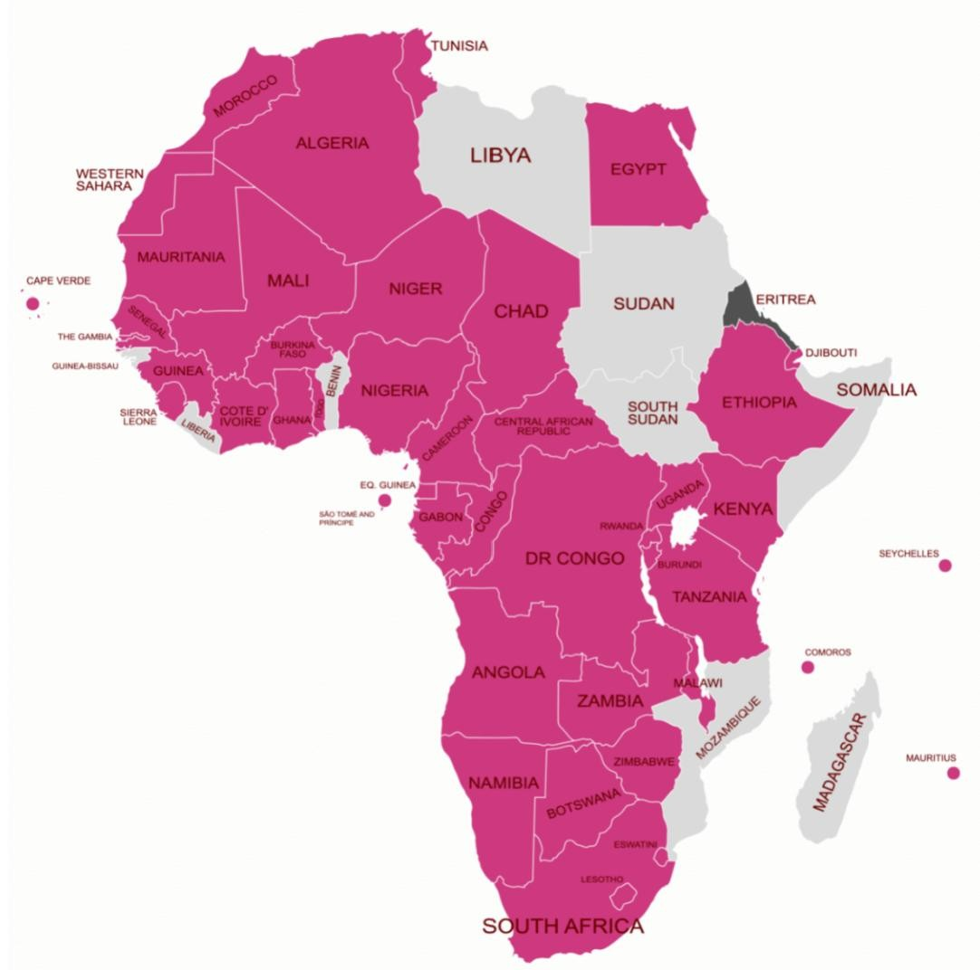
Enter AfCFTA…
Key Facts
* Largest economic bloc with a population of 1.3bn
* US$3.4 Trillion in Revenues
* Established in 2018
Ratified by 44 Countries

Slide 19
Africa Continental Free Trade Agreement
The African Continental Free Trade Area (AFCFTA) is a free trade area founded in 2018 with trade commencing as of January, 2021. It was created by the African Continental Free Trade Agreement among 54 of the 55 African Union nations. The free trade area is the largest in the world in terms of the number of participating countries since the formation of the World Trade Organization. Accra, Ghana serves as the Secretariat of AfCFTA and was commissioned and handed over to the AU by the President of Ghana Nana Akufo-Addo on August 17, 2020 in Accra. The agreement connects 1.3 billion people across the continent with a combined GDP estimated at US3.4 trillion
Regarding the advantages, AfCFTA aims to promote industrialization and diversify economies by encouraging the development of regional value chain and the manufacturing sector. This diversification can lead to increased productivity, job creation and higher value-added exports among African countries.

Slide 20
What is the AfCFTA Promise?
  AfCFTA is set to:
Create a liberalized market for goods and services
Contribute to the movement of capital
Facilitate investments through the creation of a large market
Catalyze the introduction of new technology to boost productivity
Enhance competitiveness of members economies
Promote industrial development through diversification
Develop value addition systems for products
Eliminate tariffs on intra-Africa trade, making it easier fo businesses to trade within Africa and benefit from their own growing market
Introduce regulatory measures such as sanitary standards and eliminating non-tariff barriers to trade
Establish in the future a common continental tariff market

Slide 21
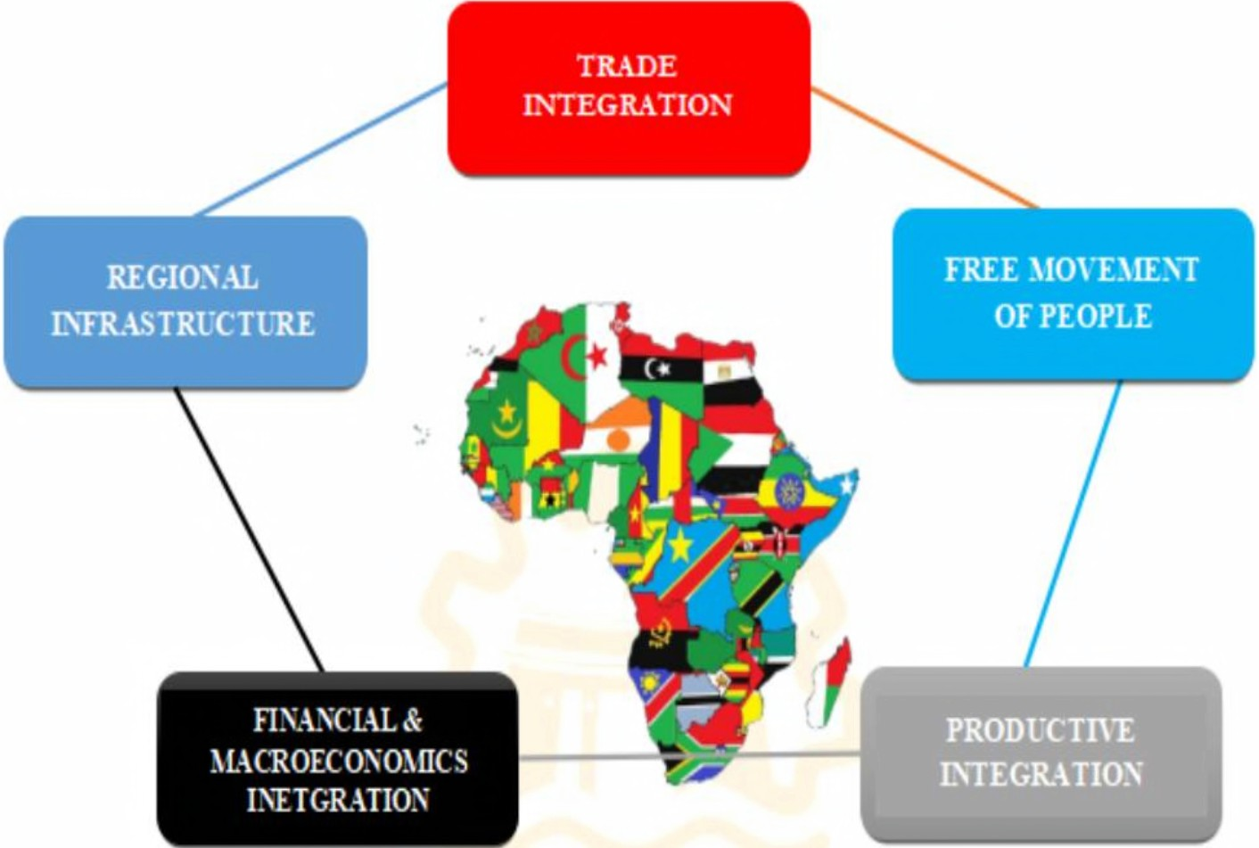







AfCFTA Potential Benefits…
55 member states
of the AU have signed
the AfCFTA agreement
55 member states
of the AU have signed
the AfCFTA agreement
AfCFTA 1s the largest free trade
area in the world measured by the number of countries p.,ticipating
88% of rules of origin have been completed with only
automotive and textile sectors remaining,41 countries have submitted their tariff offers
The AfCFTA has the potential to lift 30 millionout of extreme poverty
The AfCFTAconnects 1.3 billion
people across 55 countrieswith a combined GDP of
AfCFTA is expected to boost Africa's income by $450 billion
by 2035 a gain of 7 p:_)rcent
8 Africancountries already kick started
trade in 96 productsunder the Guided
Trade Initiative
while adding $76 billionto the
income of the rest of the world

Slide 22
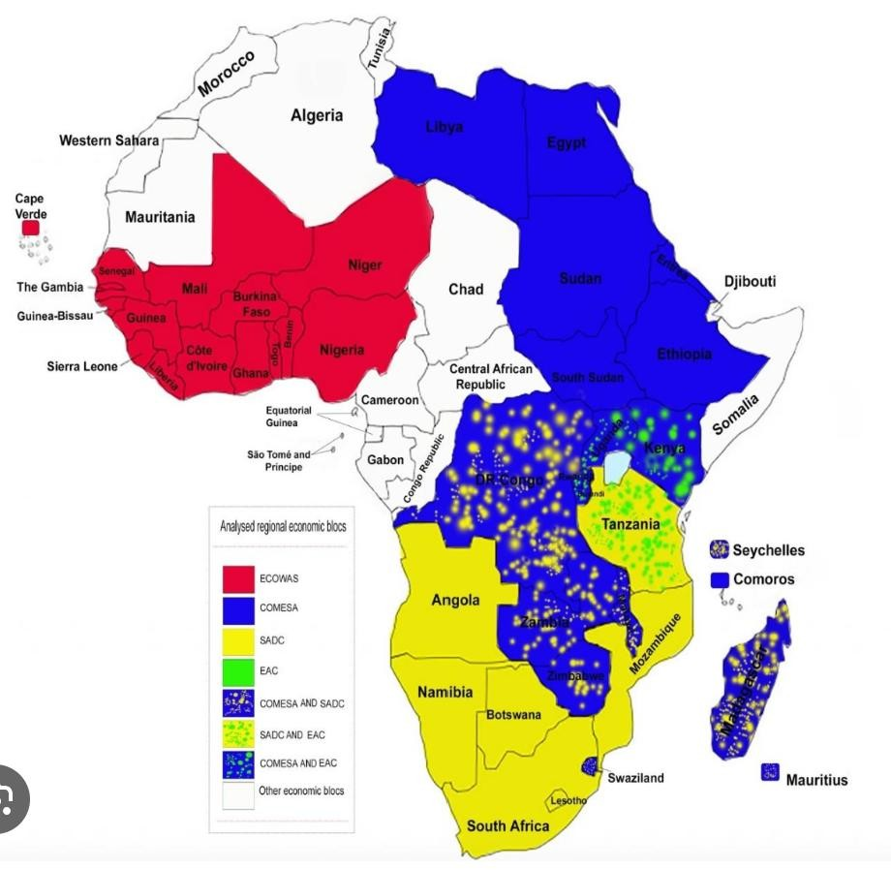
Africa’s
Regional
Economic
Blocs…Disintegrated
Regional Blocs
* Arab Maghreb Union
* ECOWAS
* COMESA
* EAC
* SADC
* Central Africa

Slide 23
Summary on why AfCFTA…
* AfCFTA aims to create a single market for goods and services, free movement of people,and expand intra-Africa trade
* Will create a more integrated Africa in the global supply chain network
* Reduction of tariff & non-tariff barriers, ease of African producers’ access to regional markets and inputs, development of regional value chains,
* Leverage regional comparative advantages, diversify exports, upgrade technologies, and increase competitiveness in the global market
* Ensuring level playing field for African businesses and investors, investment in higher- value-added goods.
* Increased intra-African trade, create opportunities for learning, innovation, and collaborate among African businesses.

Slide 24

Background to a Common African Currency…
•
.* The clamour for a common currency for Africa dates to the creation of the Organization of African Unity (OAU) in 1963.
* Aimed at promoting unity, solidarity, economic
integration among African states & peoples.
* OAU transformed into African Union (AU) in
2002, which made the establishment of a single
currency one of its key objectives.
* AU envisioned a gradual process of monetary integration, starting from strengthening existing regional economic communities and creating new ones
* Ultimate aim: creation of an African Economic
Community, an African Central Bank, and a single.

Slide 25
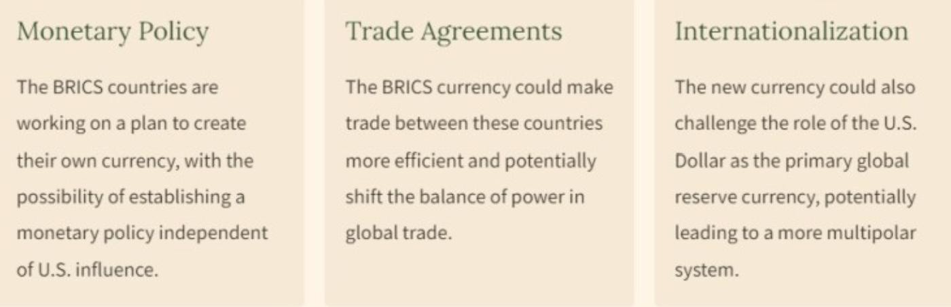
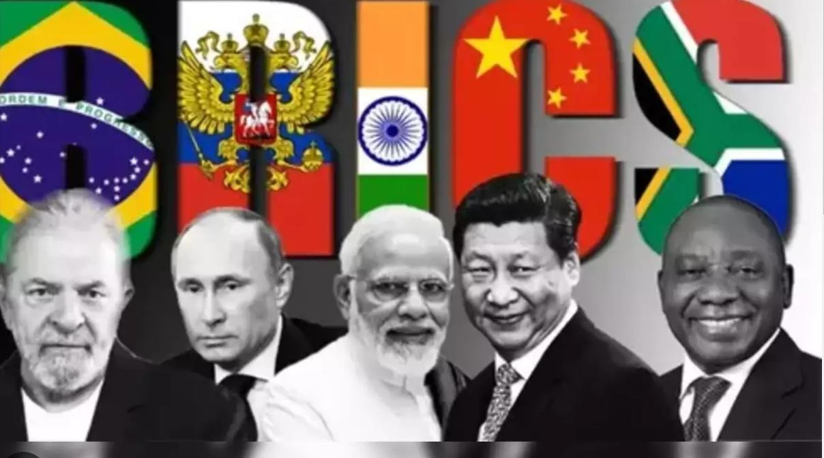
Clamour for a Common Currency started with BRICS…

Slide 26
Objectives of a Common Currency…
To reduce the costs and risks of exchanging multiple currencies across continent
To enhance price stability and transparency, which can foster competition and efficiency.
To increase monetary policy coordination and credibility, which can lower inflation and interest rates.
To create a larger and more integrated market, which can attract FDI and boost growth and development
To foster a sense of common identity and solidarity among African countries.
To reduce disparities in currencies and create an efficient and unified payment systems to promote intra-African trade.

Slide 27
Challenges to a Common Currency…
Diversity &
heterogeneity
of
African
economies:
different
orientation.
Lack of convergence & compliance with the macroeconomic criteria required for monetary union: fiscal deficit, public debt, inflation, exchange rate stability, and foreign reserves.
sovereignty and policy autonomy to
distributing, and
levels
of
development,
structure, performance
&
policy
Political
& institutional
obstacles
to
surrendering
national
a supranational authority.
Technical
&
logistical
challenges
of
designing,
producing,
managing a new currency.
Potential costs & risks of
losing monetary policy flexibility
and exchange rate adjustment in response to
Shocks.

Slide 28
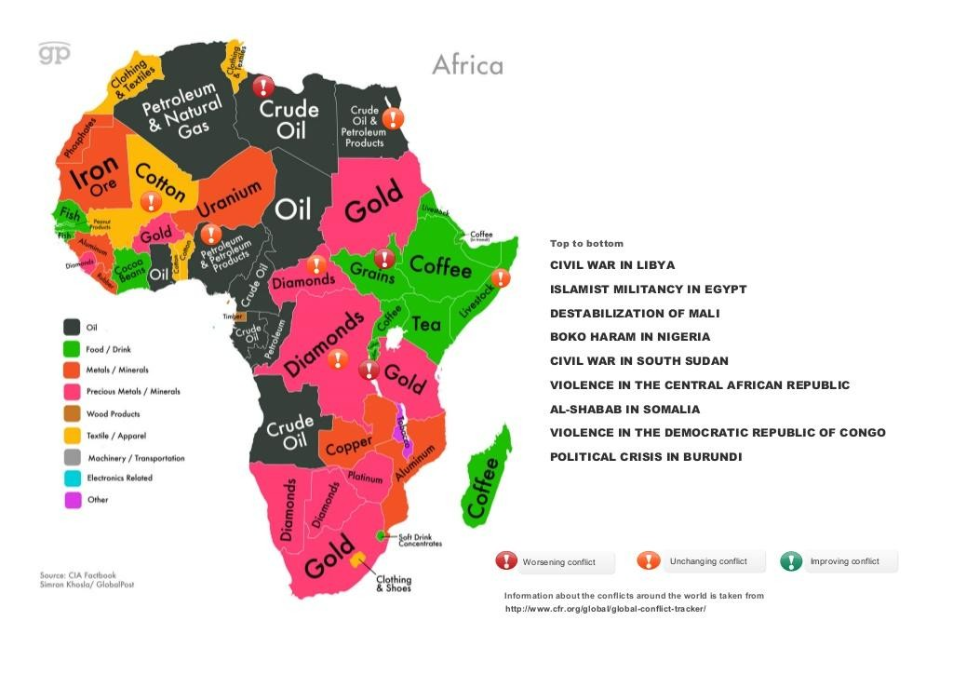
Who is benefiting from Africa’s growth and wealth?
1. Somali Civil War (3 lost decades)
2. Sierra Leone Conflict (2 lost decades)
3. Congo Conflict (5 lost decades )
4. Rwanda (Rising from the ASHES)
5. Burundi Civil War (3 lost decades)
6. Nigerian Civil War (Sleeping GIANT)
7. Ethiopia - Eritrea Trouble (Identity crisis) & On-going crisis in from2020 in the Tigray Region

Slide 29
The Nigeria Supply Chain Management Professionals and African Continental Free Trade Areas

Slide 30
What is in it for the Nigeria Supply Chain Professionals
Opening up of AfCFTA means that ECOWAS countries need to balance its relations with external actors: China, India, Europe, and the US, which will seek to increase their economic and strategic interests in the region…while pursuing the integration agenda of ECOWAS. Africa will have to leverage its comparative advantages and negotiate favourable terms of engagement with these partners West Africa will also have to cooperate with AfCFTA especially, Nigeria and others with its vast resources.
The Nigeria Supply Chain Professionals should begin to think out of the box, by recognizing that the SCM is not just about procurement and supply rather, it is a fundamental tool necessary to stimulate economic growth and thus, assisting the Federal government towards the realization of her economic policy anchored on manufacturing and real sector of the economy and thus enhancing our capacity to export finished products out of the country.

Slide 31
The 2025 Budget – Key Considerations to Unpack for 2025
The 2025 Budget – Key Considerations to Unpack for 2025
Increased Productivity
Sustainability Management
Digital Economy and Impact of AI
Social Development
Enhancement of Security among others.
The 2025 Budget underscores government’s focus on:
Economic Stability
Infrastructure Growth
Social Investment

Slide 32
2025 Budget – Sectoral Allocations
2025 Budget – Sectoral Allocations
Social Development N600.77bn 1.09%
Technology N1.5trl 2.95%
Agriculture N2.27trl 4.12%
Health care N2.38trl. 4.32%
Education N3.59trl. 6.52%
Infrastructure N5.67trl. 10.32%
Security and Defence N6.27trl. 11.29%

Slide 33
Expenditure Breakdown
Defence & Security: Largest allocation
Social Services (Education & Health): High funding for human capital
Infrastructure: Key investments in transport & Power
Social Programs: Poverty reduction &welfare
* The Supply Chain Management professionals should be concerned about expenditure management as shown, in the breakdown above by ensuring that, they are properly and professionally managed with a view, to realizing the Value-for-Money (VfM) principle in procurement and supply chain activities and this should be our focus.

Slide 34
Towards Actualizing the Export Promotion Initiatives of the Federal Government of Nigeria.

Slide 35
SCMP – Towards actualizing Our Export Initiatives
The SCM professionals should endeavour to research further into the enhancers involved in the development of businesses such as the MICRO, SMALL & MEDIUM ENTERPRISES (MSMEs) towards enhancing their capacity in manufacturing for export.
Encourage the understanding of the mandate of the Nigerian Export Promotion Council (NEPC) in addressing the ease of doing business of which the government is pursuing vigorously through policy enunciation.
Deeper understanding of the INCOTERMS (International Commercial Terms) and it applicability is fundamental
The professionals from various field s in Engineering, should partner with the SCM professionals in identifying, locally manufactured machines for use in production as a substitute to importation because, PSCM isn’t just about, processing request leading to an award and finalization of contract rather, encouraging local production for export.

Slide 36
SCMP – Towards actualizing Our Export Initiatives
We encourage the SCM professionals to participate actively towards enhancing the operations especially, the manufacturing activities at the various Active Free Trade Zones in Nigeria such as Ogun Guangdong Free Trade Zone, Lagos Free Trade Zone, Lekki Free Trade Zone, Newest Airline Services & Logistics EPZ, Dangote Industries Free Zone, Ladol Free Zone, Nigeria Aviation Handling Company (NAHCO), Nigeria International Commerce City ( Eko Atlantic), Snake Island Intergrated Free Zone, Tomaro Industrial Park, Quits Aviation Services FZ, Pan African Catering Services FZ, NASCO FZ and Alaro FZ.
Finally, Procurement and Supply Chain Management professionals, trained and certified by the Chartered Institute of Purchasing and Supply Management of Nigeria,

Slide 37
SCMP – Towards actualizing Our Export Initiatives
should upscale our knowledge and take seriously our avowed professional commitment that placed us, to strategically manage the PSCM functions in both Public and Private sectors of the Nigerian economy. We MUST continue to build our capacity and capability as well as, be mindful of the fact that, for a reliable and functional economic prosperity to be attained, we all owe it a collective responsibility to assist the Federal government of Nigeria, under the leadership of President Bola Ahmed Tinubu GCFR, to succeed in his economic reform agenda by reducing the incidences of procurement related corruption most especially, in the public sector followed by the private sector organization. PSCM Professional MUST checkmate the ugly vices of fraud and corruption in procurement for us to have meaningful growth and development.

Slide 38
Thank You All For Listening.
References:
1. KISM and CIPSMN Dialogue - IFPSM Members on AfCFTA -383838 2023
International Purchasing Management Lecture Note .Dr Abdul A. Mamman FCIPSN, 2021
Sustainable Procurement management - M , 2019
Evolution of Procurement & Supply Chain Management: An MPDP Paper 2022 – Prof. Mohammed J. Aliyu , 2020
X – ray of Nigeria’s 2025 Budget Provisions : Messrs PwC

