Slide 1
.
C H A R T E R E D I N S T I T U T E O F P U R C H A S I N G A N D S U P P L Y M A N A G E M E N T O F N I G E R I A.
Presents a Paper
, Titled: Sustainable Warehousing Practices: Energy Efficiency, Waste Reduction and Safety
THEME: SUSTAINABLE PROCUREMENT AND SUPPLY CHAIN MANAGEMENT IN NIGERIA: A NECESSARY ROUTE TOWARDS ACHIEVING EFFICIENT MANAGEMENT OF RESOURCES IN PUBLIC AND PRIVATE SECTOR ORGANIZATIONS AND ITS IMPACT ON AFRICA CONTINENTAL FREE TRADE AREAS
AT THE BATCH “A” MANDATORY PROFESSIONAL DEVELOPMENT PROGRAMME (MPDP) OF THE INSTITUTE FOR MEMBERS ONLY.
BY, Dr Abdul A. Mamman MNIM, , CPA, FCIPSN Coordinator, CIPSMN, North Central Zone
&
Dr. Femi B. Adedokun. PhD, MCIPSN
VENUE: LAGOS AIRPORT HOTEL, 111, OBAFEMI AWOLOWO WAY, ALLEN AVENUE JUNCTION, IKEJA – LAGOS. Held on the 23rd – 25th April, 2025

Slide 2
Objective of this paper
This paper aims at presenting and identifying sustainable warehousing practices that, specifically analyze the current state of energy consumption and waste generation in warehouses as well as, explore sustainable warehousing practices that optimize energy efficiency, minimize waste and ensure safety, providing actionable paths, for warehouse operators to adopt environmentally responsible and socially conscious strategies that will ultimately, connect with effective and efficient logistics being subsets of supply chain management functions.

Slide 3
Definition of a Warehouse
A warehouse is a facility that, along with storage racks, handling equipment and personnel and management resources, allows us to control the differences between the incoming flow of goods (received from suppliers, production centers, etc.) and the outgoing flow of goods (goods being sent to production, sales, etc.). Usually, these flows are not coordinated, and this is one of the reasons why it is important to have storage facilities. Warehouses are used by manufacturers, importers, exporters, wholesalers, transport businesses, customs, etc. They are usually large plain buildings in industrial parks on the outskirts of cities, towns, or villages.

Slide 4
Why Warehouse?
Warehousing exists to contribute to manufacturing and distribution efficiency because they facilitate efficient storage, management and provide security for storage enable inventory control and streamline other fulfillment, leading to costs reduction and improved customer satisfaction

Slide 5
DEFINITION OF INVENTORY
Ask any group of people associated with manufacturing what inventory is and you will get three types of answers.
The finance is concern with costs, money, an asset or cash in material form
Operations is concern with finished goods, raw materials, work-in-progress or process of materials used in the products.
Procurement is concerned with efficient and effective right quantity and quality materials flows into the store house

Slide 6
INVENTORY POLICIES
An important part of the inventory manager’s role is the setting of inventory pictures as demonstrated below:
Stocking level and inventory turns
Order frequency and quantity
Safety stock and customer service
Surplus and excess definition
Inventory accuracy and adjustments
Organizational development, education, training
POLICIES
Dependent versus independent demand
Inventory allocation
Order quantity
Safety stock
Forecast
PLANNING
Issues and receipts
Adjustments
Transfers
Cycle counting
Identification
CONTROL
These policies are the rules that will dictate:
When orders are placed on suppliers
How much those orders will be for
More will be discussed later in the lecture

Slide 7
BREAKING BULK
The second importance of warehousing activity is breaking of bulk as demonstrated in figure 2a and b
Direct shipment
R 1
factory
R 2
R 3
7
mjaliyu’spaper

Slide 8
Benefits of warehousing are classified as economic and service. It occurs when overall logistics costs are reduced as regard:
Consolidation and break-bulk
Sorting
Seasonal Storage
Reverse logistics
Fig. 2b
R 1
Factory
Ware house
R 2
R 3
Break bulk through Warehouse
8
mjaliyu’spaper

Slide 9
Types of warehouses
At times, the business activity of a company requires one or more types of storage facilities such as:
one for raw materials,
one for semi-finished products,
one for finished products, etc.
All of these have to be arranged on the basis of their specific operational needs, and in accordance with the restrictions and potential of each location and its surroundings.
The best way to classify the different types of warehouses currently available is to group them according to their common features namely:
i. According to the nature of the product
There are warehouses specializing in coils, flammable products, profiles, small materials, spare parts and perishables and even warehouses that are for general use, among others.

Slide 10
Types of warehouses Cont’d.
The building
It can also be a criterion for its classification. Buildings can be classified as open air warehouses, industrial buildings, basements, depots, cold storage chambers, rack-supported warehouses (the racks form part of the building's constructive system), etc.
Iii According to the flow of materials,
Installations can be grouped into those used for raw materials, components or semi-finished products, finished products, intermediate warehouses, for warehousing, for distribution, etc.
iv. In terms of location
Warehouses can be central, regional, or for transit.
According to the extent of their mechanization
They can be manual, conventional, or automated.

Slide 11
Various types of Warehouse Design
There are different types of warehouse designs based on how they are laid out and how they store things. Here are some common ones:
1. Traditional Warehouse Design: This is where there are aisles between rows of shelves or racks. This works well for businesses that handle a lot of goods and need easy access to each item.
2. Flow-through Warehouse Design: This is where products come in one end and go straight to the shipping area without being stored. This is good for businesses that ship things a lot.
3. Cross-docking Warehouse Design: This is where goods go from one dock to another without being stored. This is used in industries where speed and efficiency are important.

Slide 12
Various types of Warehouse Design Cont’d.
4. Automated Warehouse Design: This is where machines do a lot of the work, like moving things around and keeping track of inventory. This is good for businesses that want to be fast and efficient.
5. Mezzanine Warehouse Design: This is where a second level is added to the warehouse to create more space for storage. This is used in industries where there isn’t much floor space.
6. Cold Storage Warehouse Design: This is where things that need to stay cold are stored. These warehouses have special equipment to keep the temperature low. This is used in industries like food and medicine.
7. High-Density Storage Warehouse Design: This is where the shelves or racks are designed to hold things in the most efficient way possible. This creates more space for storage.

Slide 13
Various types of Warehouse Design Cont’d.
8. Hybrid Warehouse Design: This is where a mix of different designs is used to create the best layout for a specific business.
9. Eco-Friendly Warehouse Design: This is where the warehouse is designed to be good for the environment. This includes things like using less energy and reducing waste.

Slide 14
The main tasks performed in a warehouse
* Receipt of goods
* Verification of those goods
* In-house transport (between different parts of the warehouse)
* Storage and safe-keeping of items
* Preparation of orders and the consolidation of loads
* Dispatch of goods
* General management and processing of information related to the stock, workflows, demand, etc.

Slide 15
What elements are involved in a warehouse?
A number of factors must be taken into account when planning a facility. The most important of these are the products to be stored, the flow of materials or goods, the space available to house them, the storage equipment –such as racks and handling equipment–, the human factor (personnel), and the company’s management system and policies.
Based on the above, a series of information must be collected. This information, which is stipulated below, will in turn influence the various aspects of the facility and must be taken into account during its development.

Slide 16
What are the different parts of a warehouse?
The simplest warehouses normally have access doors, an open area for maneuvering and verification, a storage area where the goods are located, a management office for controlling operations, and toilets and changing rooms for personnel . Warehouse with a very simple configuration: storage area, management area, changing rooms and bathrooms for personnel.
Starting with the simplest configuration, other areas can be added. This includes areas like:
reception,
packaging and consolidation,
dispatch,
recharging forklift batteries,
as well as loading docks.

Slide 17
A typical warehouse design

Slide 18
Example of a Loading dock distribution at a warehouse facility.

Slide 19
Typical Sectors of a Warehouse
In turn, a warehouse can be divided into sectors according to the product being handled or the work operations. The following diagram illustrates an example of this type of organization:
1. Office and customer services.
2. Loading and unloading docks.
3. Reception and verification.
4. Dispatch.
5. Warehouse for high turnover or over-sized product.
6. High turnover picking off pallets.
7. Warehouse for odd-shaped products.
8. Warehouse for medium turnover components.
9. Warehouse for high turnover components.
10. Warehouse for low turnover components.
11. Warehouse for high-value products.
12. Packaging and consolidation.

Slide 20
What is Warehousing?
Warehousing is a process of storing goods in a warehouse for the purpose of distribution, sale, or manufacturing. Warehouses are used for storing goods for an extended period of time and are typically equipped with storage areas, loading docks, conveyors, and other material-handling equipment.19 Nov 2022
Warehousing is the process of storing goods until they are ready for transport and understanding its importance can play a crucial role in your business operations. Discover the different types of warehouses and key features that will help improve efficiency while reducing costs.
Warehousing plays a pivotal role in modern business operations, serving as the backbone of supply chain management and influencing overall organizational efficiency. By providing a centralized location for inventory storage, warehouses enable businesses to optimize their logistics processes and ensure timely delivery of products to customers.

Slide 21
Sustainable Warehousing Practices: Energy Efficiency, Waste Reduction and Safety

Slide 22
What does Sustainability stand for?
Sustainability consists of fulfilling the needs of current generations without compromising the needs of future generations, while ensuring a balance between economic growth, environmental care and social well-being.

Slide 23
What is Sustainable Warehousing Practice?
Sustainable Warehousing refers to the implementation of environmentally friendly and socially responsible practices in warehouse operations, design and management. It aims to minimize the ecological footprint of warehousing activities while ensuring efficient , safe and cost effective storage and distribution of goods. In another sense, Sustainable warehouses incorporate low-impact environmental strategies, practices and design techniques that reduce energy consumption and minimize waste production.

Slide 24
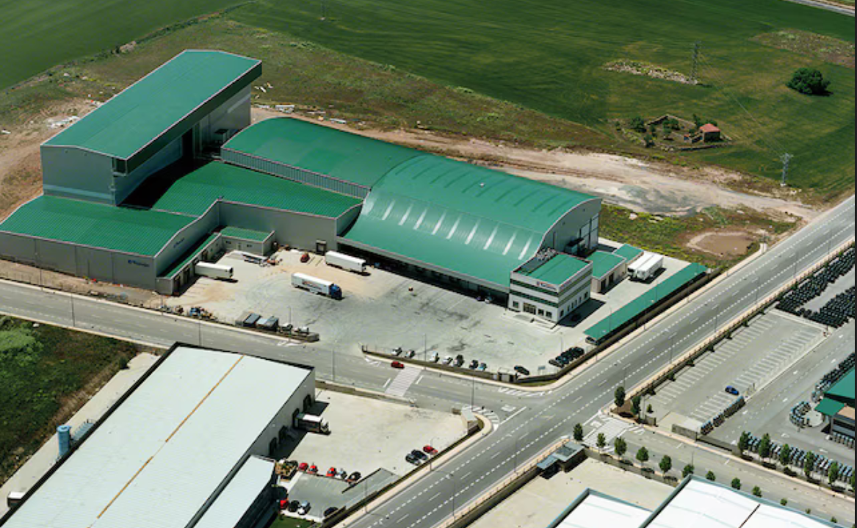
Exterior of a typical sustainable warehouse building.

Slide 25
Interior of a sustainable warehouse building.

Slide 26
What are the key aspects of sustainable warehousing?
The Key aspects are as follows:
Energy efficiency
Waste reduction
Water conservation
Sustainable materials
Safe working conditions
Community engagement
Continuous improvement

Slide 27
Energy efficiency
Energy efficiency simply means using less energy to do the same task or produce the same result, and thereby eliminating energy waste. Energy-efficient buildings and homes use less energy to heat and cool. Energy-efficient appliances and electronics use less energy to run.
* It is known that using renewable energy sources, LED lighting, and energy –efficient equipment to reduce energy consumption.
*Electrical efficiency, useful power output per electrical power consumed.
* Mechanical efficiency, a ratio of the measured performance to the performance of an ideal machine.
* Thermal efficiency, the extent to which the energy added by heat is converted to net work output or vice versa.

Slide 28
Waste reduction
This is referred to as implementing recycling programs , minimizing packaging and reducing waste sent to landfills.
* Waste reduction is anything that reduces waste by using less material in the first place. Reducing waste can be as simple as using both sides of a sheet of paper, using ceramic mugs instead of disposable cups, or buying in bulk rather than individually packaged items.
* The 5 Rs of waste management are as follows: Refuse, Reduce, Reuse, Repurpose and Recycle. In practice, the 5 Rs will break down the waste lifecycle into stages so that, businesses can identify actions they can take to reduce the amount of waste and pollution they produce.

Slide 29
Water conservation
This talks about implementing water –saving measures, such as rainwater harvesting and greywater reuse.
* The process of protecting an endangered plant or animal species in its natural habitat is commonly known as in situ conservation. On the other hand, ex situ conservation is the relocation of endangered or rare species from their natural habitats to protected areas equipped for their protection and preservation.
It involves the following methods:
* Rainwater Harvesting
* Groundwater Recharge
* Upgrading Operational Infrastructure
* Fixing All Minor and Major Leakages
* Using Water-Efficient Appliances
* Reusing and Recycling Water

Slide 30
Sustainable materials
Sustainable materials talks about using recycled, recyclable, or sustainably sourced materials for packaging, pallets and building materials.
* Life below water: Avoiding the use of plastic bags to keep the oceans clean.
* Life on land: Planting trees to help protect the environment.
* Responsible consumption and production:
* Recycling items such as paper, plastic, glass and aluminum.
* Sustainable cities and communities:
* Biking, walking or using public ...

Slide 31
Safe working conditions
This is aimed at ensuring a safe and healthy work environment through proper training, equipment, and protocols.
* Safe working practices are a set of procedures, rules, and processes designed to ensure the health and safety of people in the workplace. In construction, they play a vital role in protecting employees, contractors and the public from injuries, illnesses, and accidents in the workplace.
* The conditions under which employees have to work. This includes matters such as permitted breaks, the state of heating, lighting, and ventilation of workplaces, the safety and comfort of machinery, vehicles, and other equipment, normal manning levels, and disciplinary procedures.

Slide 32
Community engagement
This is made possible by engaging with local communities, supporting local businesses , and promoting sustainable practices through the supply chain.
* Community engagement requires intentional interactions between communities and public decision makers. Emphasis on the lived experience of community members taking a front seat and local knowledge inflecting decision-making processes, challenges a top-down approach to public decision making.
* Other terms used to talk about community engagement include civic engagement, public consultation, public participation, community consultation, community collaboration, stakeholder management, and community management.

Slide 33
Continuous improvement
This calls for regular monitoring and assessing warehouse operations to identify areas for improvement and implement sustainable innovations.
* Continuous improvement, sometimes called continual improvement, is the ongoing improvement of products, services or processes through incremental and breakthrough improvements. These efforts can seek "incremental" improvement over time or "breakthrough" improvement all at once.
The basic principles of continuous improvement are as follows:
* Focus on Customers.
* Benefiting from Employees' Ideas.
* Leadership Support.
* Applying Incremental Changes.
* Using Data-Driven Methods.
* Continuous Improvement Software.

Slide 34
Some known benefits of Sustainable Warehousing.
The benefits are:
Reduce energy consumption and greenhouse gas emissions
Lower waste management costs and environmental impact
Improved employee safety and well-being
Enhanced brand reputation and customer trust
Compliance with environmental regulations and standards.
Potential cost savings through efficient operations and reduce waste.

Slide 35
Conclusion
The overall benefits of sustainable warehousing exist in large number and those saddled with the responsibility must think out of the box, by ensuring that, a lot more research can be conducted with recourse to the international best practices. The ability of those saddled with the warehousing function and acting within the scope of supply chain management activities should perform by adopting sustainable warehousing practices.
Businesses can contribute to a more environmentally friendly and socially responsible supply chain through sustainable operations and management, energy –efficient equipment and machinery, sustainable packaging and materials handling, waste reduction and recycling programs, employee training and engagement in sustainability practices.
By employing technology and innovation, you can achieve most of the organization’s objectives through, automation and robotics for increased efficiency, IoT sensors and data analytics for energy monitoring ,electric and alternative-fuel vehicles for transportation aiding supply chain visibility and optimization for reduced carbon foot print and thus, enriching the full potentials in logistics as well as supply chain management.

Slide 36
Thanks For Investing Your Time With Me.

Slide 37
References:
1. Warehouse management - Maxculux International 2022
Cyzerg warehouse design . Anthony Kursk and Politiskwi , 2020
Sustainable warehouse management - Malinowska , 2019
4. Warehouse management and Optimization – Mohammed J. Aliyu , 2016

